Slide 1
بنام خداوند جان وخرد
قال علی(ع)
ما من حرکه الا وانت محتاج فیها الی المعرفه
هیچ حرکتی نیست مگر آنکه در انجامش به دانش نیازمندی

Slide 2
Frozen Shoulder
Hossein saremi,MD
Orthopaedic Hand &shoulder surgeon
Hamedan university of medical sciences

Slide 3
Definition
Duply 1896:peri-arthritis scapulohumerale
Codman1934:frozen shoulder,a clinical pattern of muscle spasm and GH stiffness
Neviaser,:Adhesive capsulitis,chronic inflamatory process involving the capsule of the shoulder
Symposium AAOS1992:A condition of uncertain etiology,chracterized by significant restriction of both active and passive ROM that occursin the absence of known intrinsic shoulder disorder

Slide 4
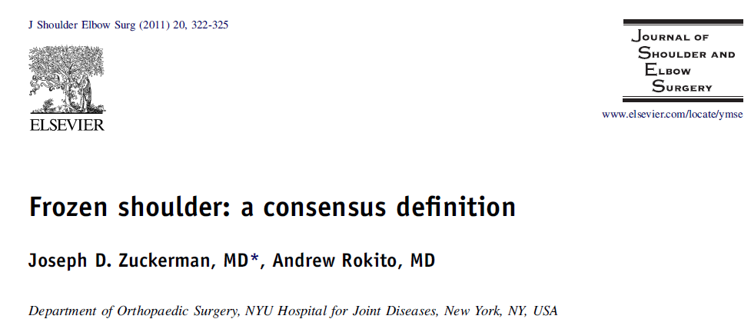
Definition
The absence of a specific definition of this condition makes it difficult to compare the results of different studies that describe either diagnostic or treatment modalities for this condition.
The absence of a specific definition of
this condition makes it difficult to compare the results of
different studies that describe either diagnostic or treatment
modalities for this condition.

Slide 5
Definition
Definition: Frozen shoulder is a condition characterized by
functional restriction of both active and passive shoulder motion for which radiographs of the glenohumeral joint are essentially unremarkable except for the possible presence of osteopenia or calcific tendonitis

Slide 6
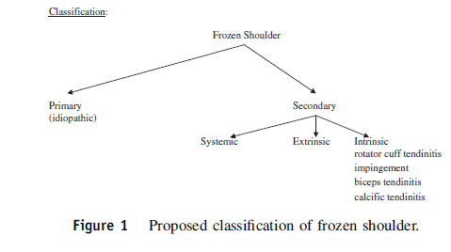
Frozen shoulder: a consensus definition

Slide 7
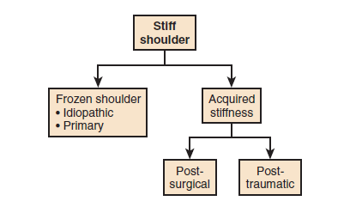
Classification

Slide 8
Pathomechanics
Normal ratio of glenohumeral to scapulothoracic motion is 2:1
Capsule is free of tention until terminal degrees of motion
Antrosuperior capsule(rotator interval,coracohumeral lig,superior GHL) -----ER arm in 0 degree ABD
Middle GHL and anterio band of IGHL----ER in 45-90 degree ABD
Posterior capsule----IR with the arm at side.Tension is shifted inferiorly with increasing angles of elevation

Slide 9
Pathomechanics
Posterior capsular plication----limitation of forward elevation,internal rotation,horizontal adduction and caused consistent antrosuperior translation of the humeral head during forward flexion
Anterior capsular plication----Deficit in ER,greater joint reaction forces toward the opposite side of glenoid and excessive wear of posterior glenoid articular cartilage

Slide 10
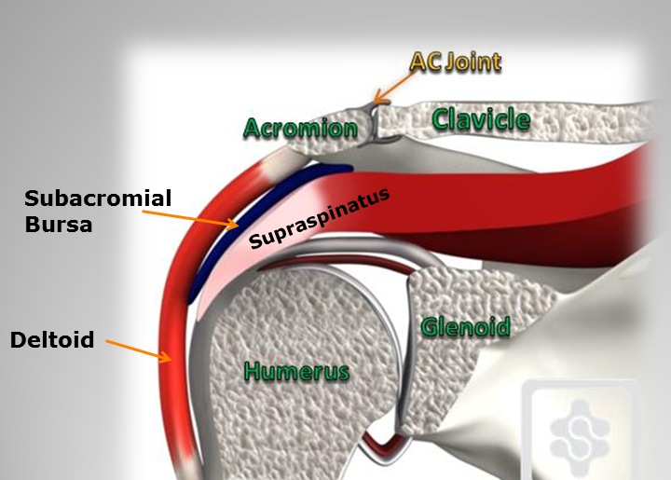
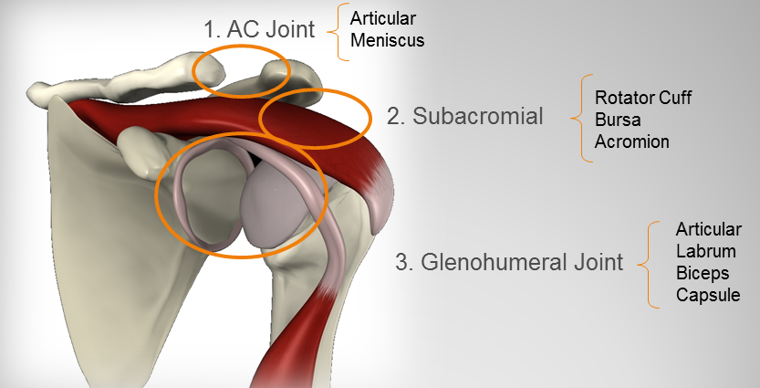
Sub acromial &sub deltoid plane
Sliding surface between the Deep side of the deltoid,the acromion,the coraciod process and its tendons and the superficial side of the humerus and rotator cuff is
considered a secondary scapulohumeral joint
Normal biceps glide is necessary for ful glenohumeralROM

Slide 11
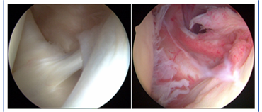
pathophysiology
Inflamation in perivascular,synovium,capsule,Biceps sheath Fibrosis
Immunologic,biochemical,or hormonal imbalances

Slide 12
Epidemiology
Incidence ingeneral population 2-5%
Nearly 70% are women
20-30% develop stiffness in the contralateral shoulder
It dosenot affect the same shoulder twice

Slide 13
Predisposing Factors
Age:majority of patients are between 40-60Y,
Unusual for idiopathic F.SH <40Y ,exception of IDDM
Diabetes Mellitus:incidence 10-20%,somestudies up to 35%
The longer that a patient has been taking insulin,the greater the risk
Limited joint motion syndrome
Cheiroarthropathy
Rarely shoulder stiffnessis the initial manifestationof diabetes

Slide 14
Predisposing factors
Non-shoulder surgery:
Axillary node dissection
Neck dissection especially when combined with radiation therapy
Cardiac catheterization in the axilla
Coronary artery bypass grafting
Thoracotomy
Interventional cardiology such as catheterization or ipsilateral cardiac defiblirator
Breast cancer surgery

Slide 15
Predisposing factors
Immobility
Cervical disk disease
Thyroid disorders,Bilateral F.SH
Cardiac disease(shoulder-Hand syndrom in 10-30% of MI casses
Pulmonary disorders:tuberculosis,emphysema chronic bronchitis
Neoplastic disorders:broncogenic carcinoma,pancoast tumor,chest wall tumor,metastatic carcinoma of the humerus

Slide 16
Predisposing factors
Neurologic conditions
Parkinson disease,in 18% the first symptom of disease ,even 2 years before the onset of generalized symptoms
Hemiplegia(30% had shoulder pain and susceptible)
Sub arachnoid hemorrage
Shoulder –Hand syndrom occurs in 30-40% of stroke patients and can be terribly disabling
Brachial neuritis(parsonage –Turner syndrome)

Slide 17
Predisposing Factor
Personality disorders,anxiety,depression
Reaction to medication
Barbiturates
Fluoroquinolones
Nelfinavir
Isoniazid
Genetics,one report to 42%,no specific gene has been identified.in twins,it occures 2-3times more frequently than by chance
Strong association between adhesive capsulitis and dupuytren disease(dupuytren 8.27 times more common in patients with frozen shoulder)

Slide 18
Clinical Features Idiopathic frozen shoulder
Stage 1:Freezing: pain
Achy discomfort at rest,and severe pain with attemped movement
Usually present for several months or less
Difficult sleeping is an almost universal complaint
Stage 2:Frozen:pain tends to abate but motion becomes severly limited
Sleeping problem
Can last between 3 and 12 month,can become refractory and last much longer
Stage 3:Thawing:ROM slowly returns
Can take months to years
Motion restriction often persist

Slide 19
Clinical features Aquired stiffness
Dosenot follow a predictable course like idiopathic frozen shoulder
Rotator cuff strain;restricted forward elevation,internal rotation,cross body adduction
Non anatomic instability repair:diminished ER
Promimal humerus Fx:Global loss of motion

Slide 20
Physical EX
Cervical exam specially neurological Exam
American Shoulder and ElbowSurgeons Society agreed to measure and record the threecardinal planes of motion: 1.elevation in the scapular plane,
2.external rotation with the elbow near the side, 3.internalrotation using spinal segments as the reference points.
Abduction (elevation with the arm in the coronal plane)
is not considered a cardinal plane of shoulder motion.

Slide 21
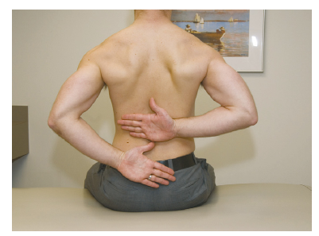
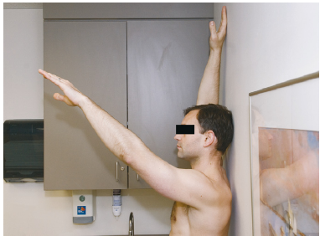
Physical EX
Palpation(patients may have tenderness at the deltoid insertion and over anterior and posterior capsule with deep palpation)
Active then passive ROM
Provocative tests(RC,instability,biceps,Acjoint)

Slide 22
Laboratory studies
CBC,ESR,CRP if there is a concern of infection
FBS,28%abnormal GTT in one study

Slide 23
Imaging
Radiographs:FX,malunion,arthrosis,AVN,Chronoc DX
MRI;
concern of underlying RC integrity
Possibility of soft tissue or bone tumor
Ultrasound ?
Arthrograghy?

Slide 24
Natural History
Self limited disease but
it is not uncommon for patient tocontinue to have some discomfort and restriction of motion even after the resolution of the thawing phase
Some patients show absolutely no improvement over time at all or show mild improvement and then reach a plateau
Involvement of dominant arm is a good prognostic factor
IDDM>10 y have a poor outcome

Slide 25
Treatment
Non operative
operative
Manipulation under anesthesia
Surgical release(open or Arthroscopic)

Slide 26
Operative treatment
Patients who donot regain satisfactoryROM or fail to demonstrate progress after 3-6 M

Slide 27
Operative treatment Manipulation
Contraindication:
Infalmatory phase
Failed previous MUA
Concomitant RC tear
Severe osteopenia
Neurologic injury
secondary stiffness as a result of previous surgery or post traumatic
chronicIDDM

Slide 28
Treatment MUA
Technique:
The use of two finger force if the capsule can not be ruptured,conversion to arthroscopic release
Beach chair position
Interscalene block
FLX Abd ER in Abd(90-0-add) cross body adduction internal rotation
Steroid after manipulation?has not proved to inhance the outcome

Slide 29
Treatment MUA
Complications: 1%
Tears of subscapularis supraspinatous,long head of the biceps
FX
SLAP& labral lesions
Gh dislocation
Brachial plexus palsy
Hematomasarticular cartilage

Slide 30
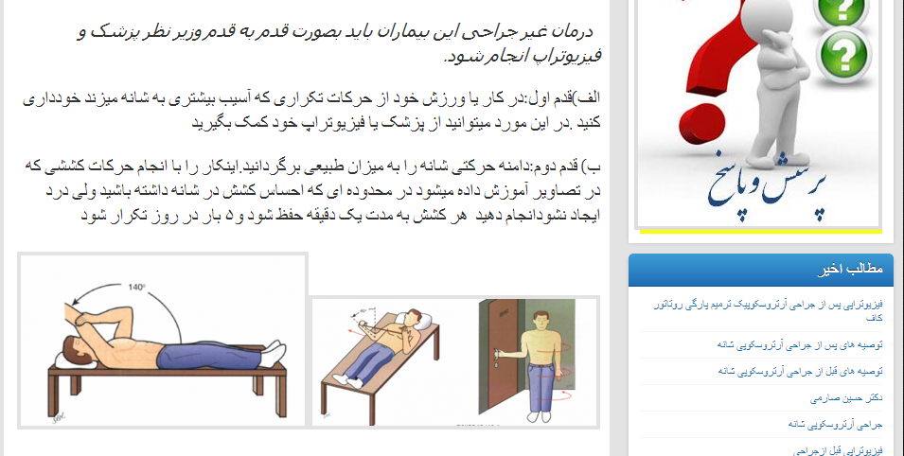
Post operative management MUA
Initiate physiotherapy on the day of the manipulation
Jackins recommondations regarding the frequency of stretching

Slide 31
Treatment Arthroscopic release
Advantages:
Can affect intra articular synovitis
Visualization of combined conditions
Visualization ,soft tissue and bony decompression
Aggressive physical therapy to manipulate the ROM is immediately acceptable and encouraged
Technique:
Manipulation before arthroscopy?

Slide 32
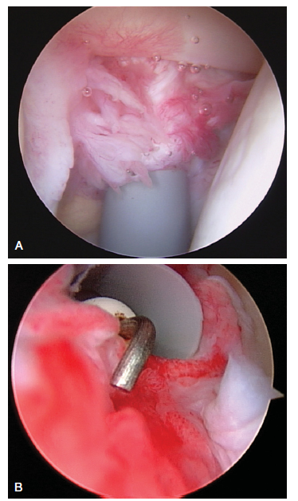
Treatment Arthroscopic release
Antro superior poetal
Rotator interval and anterior capsular release
Posterior capsular release
Sub acromial decompression(usually in secondary stiffness)

Slide 33
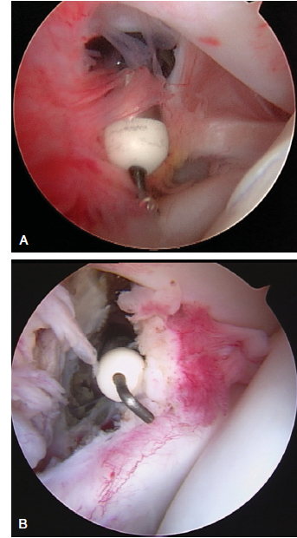
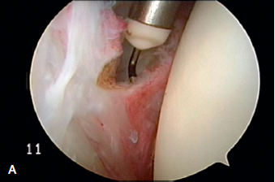
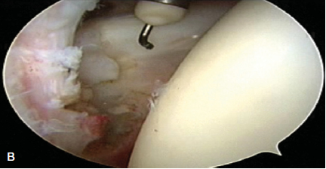
Treatment Arthroscopic release

Slide 34
Treatment (Arthroscopic release)
Post operative management:
Passive Rom immediately
CPM?
48 hours hospital course
Out patient physiotherapy 5 days a week

Slide 35
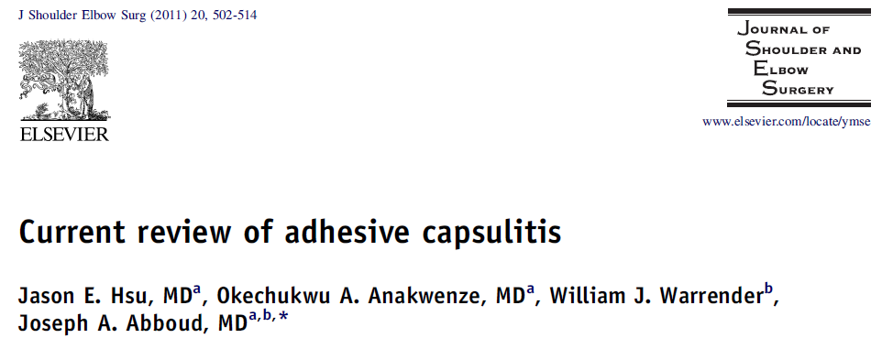
Treatment (open surgical release)

Slide 36
Tretment Open surgical release
In cases of extra articular soft tissue adhesions
May be combined with Arthroscopic release
Deltopectoral approach
Subdeltoid plane
Sub acromial space
Intrval between conjoined tendon and sub scapularis
Identification of axillary nerve and 360-degree release of subscapularis
Z plasty of subscapularis (1cm mobilization increases ER by 15-20 degrees)

Slide 37
Thank you
A hundred times every day ,I remained myself that my inner and outer life are based on the labors of other men living and dead,and that I must exert myself in order to give in the same measure as I have received.
ALBERT EINSTEIN

